Slide 1
Final Project
Neural Network Inference on FPGA
ECE 6213
Joseph Riem, Osama Yousuf

Slide 2
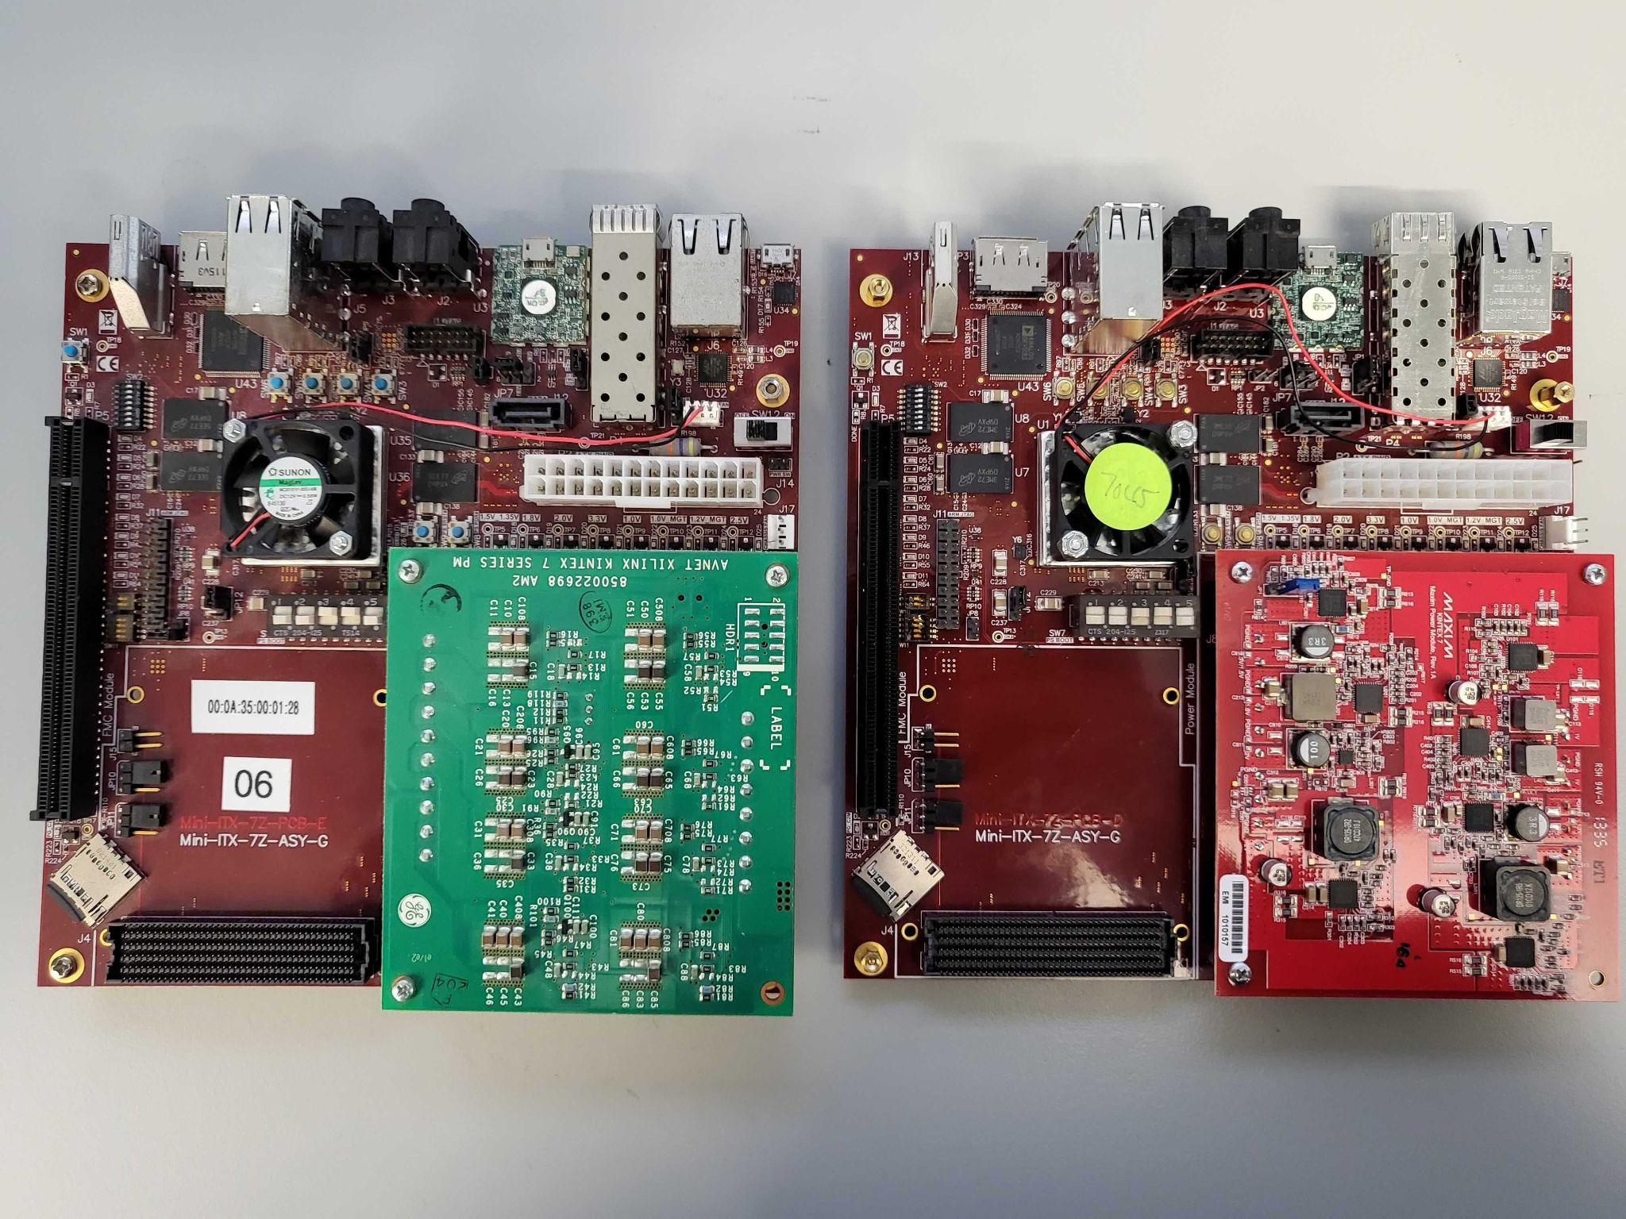
Description
Phase 0: Implement neural network training in software
Phase 1: Implement neural network inference on a Mini-ITX Zync 045/100 FPGA
Phase 2: Study how reducing network bit-precision impacts network accuracy (%)
Phase 3: Implement inference based on live-camera feed instead of preset testing dataset
Phase 4: Implement neural network training on the boards.
Notes:
For the course project, we would like to entirely focus on Phase 1, but if we’re able to get a hold of the boards and the project with sufficient time we’ll proceed with working on the other phases.

Slide 3
Specification
Linear Neural Network, without biases (for simplicity)
Dataset: MNIST
Contains 60,000 training images, 10,000 testing images
Each image is of handwritten digits labelled 0-9, and is 28 x 28 pixels originally
For FPGA implementation, we will reduce the problem size to 18 x 18, and will binarize images i.e. pixels can be either 0 or 1.
Proposed network architecture:
2-layer perceptron network
324 x 10 x 10 (might still be too big/slow for FPGA - will adjust)
Activations: ReLU/Sigmoid (needs investigation - whichever is easier to approx. for FPGA)
Loss: CrossEntropy (okay to use anything - happening in software)

Slide 4
Specification (ctd.)
Module 1: Layer
This will store a m x n matrix, should support loading initialization based on text file parser (maybe Module 4, maybe a separate module)
Each entry of the matrix would store a p-bit number (needs to be ironed out, relates to quantization)
Module 2: Activation
Needs more work since traditional activations might be too expensive to compute in FPGA
Module 3: MLP
This will be a “top” module, instantiating two layer and activation modules
Module 4: Parser for loading text files and feeding into the network
Input would be raw testing dataset files, output would be a vector with dimensions compatible with the input layer of the network
Module 5: VecMatMul
This will be the controller module for handling how a vector gets multiplied with the matrix in some layer
Notes:
Might be able to use a cordic for approximating sigmoidal activations

Slide 5
Steps for Phase 0-2 (ECE 6213)
Pipeline for training a network using backpropagation and exporting weights in software
Pipeline for pre-processing the MNIST dataset, exporting text files for parsing
Pipeline for vector-matrix multiplication for FPGA
Simple testbench -> instantiate a 2x2 matrix and compute output
Pipeline for loading pre-trained weights in FPGA
Pipeline for end-to-end testing on the MNIST dataset
Support for quantization (Phase 2)

Slide 6
Work Distribution (Phase 0-2)
Software neural network, training and exporting weights - Osama
Setting up synthesis for the FPGA - how to execute Verilog code on the Zynq boards - Joseph
Basic module/tb for vector-matrix multiplication in Verilog - Joseph
Neural network modules in Verilog for inference - Osama

Slide 7
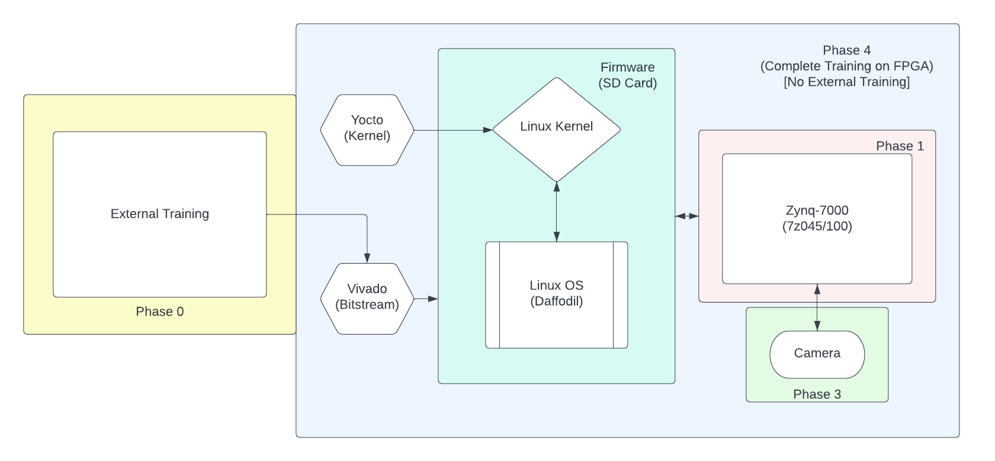
General Diagram

